Slide 1
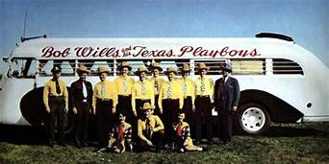
Western Swing & Cowtown
TCU Extended Education
Course 19MM40

Slide 2
The Western Swing sidemen of Fort Worth – “Carrying the Torch”
Highlight local musicians and their contributions
Marvin “Smokey” Montgomery
Buddy Brady
Joe Frank Ferguson III
Al Stricklin
Louise Rowe
Leon Rausch
Tommy Allsup
Bob Boatright
Tommy “Wolf” Morrell
“Life stories, musical influences, continued projects
Some personal recollections!

Slide 3
Marvin “Smokey” Montgomery

Slide 4
Marvin “Smokey” Montgomery
Born Marvin Dooley Wetter on March 17, 1913 in Rinard, Iowa
Sang in church and started playing banjo by age ten
Played dances and shows through high school to help his family make ends meet
At twenty, he joined a traveling tent show, and eventually ended up in Dallas

Slide 5
Marvin “Smokey” Montgomery
Chose his stage name because of actor, Robert Montgomery
Eventually joined the Light Crust Doughboys in 1935
During WWII, he manufactured six-inch shells for the U.S. Navy
Musical style and influence –
Fast banjo rhythm – “so fast his hands blurred” and “looked like smoke” on television!
Signature sound in the rhythm section

Slide 6
Marvin “Smokey” Montgomery
Later projects –
Levee Banjo Band/Levee Singers
Built Sumet-Burnet studios in 1962
Part of “For The Last Time” (Bob Wills)
Smokey and the Bearcats – 1980’s
April 1989: inducted in TX Western Swing HOF
1990’s: The Doughboys shift toward gospel
Died June 6, 2001

Slide 7
Buddy Brady

Slide 8
Buddy Brady
Born Eugene Chapman Brady on July 21, 1929 in Tyler, TX
Moved to Dallas in 1953
Fiddled for “The Shindig Show” on WFFA until 1956
Fiddled with The Lightcrust Doughboys
Campaigned with W. Lee “Pappy” O’Daniel all over Texas
Longhorn Ballroom (Dallas) – on-air channel 11 Western music segment until 1985

Slide 9
Buddy Brady
Toured with Tex Ritter in the rodeo scene
Lefty Frizzell, Big “D” Jamboree
Owner of Brady Violin Shop near SMU
Eventually became the house band for the Mesquite Championship Rodeo in 1989 until his death on November 16, 2013

Slide 10
Buddy Brady

Slide 11
Joe Frank Ferguson III

Slide 12
Joe Frank Ferguson III
Born April 22, 1914 in Fort Worth, TX
Bassist for Lightcrust Doughboys and Bob Wills & The Texas Playboys
Performed for the “Original Texas Playboys” – final concert in 1986 at Will Rogers Coliseum
Died February 14, 2001 in Fort Worth

Slide 13
The Last “Original Texas Playboys” Concert
November 16, 1986 – Will Rogers Coliseum
Lineup –
Smokey Dacus, drums
Leon McAuliffe, steel guitar
Joe Frank Ferguson, bass
Eldon Shamblin, guitar
Clarence Cagle, piano
Leon Rausch, vocals
Gene Gasaway, fiddle
Bob Boatright, fiddle

Slide 14
The Set List….
Texas Playboy Theme Big Ball's in Cowtown Boot Heel Drag (instrumental) Dusty Skies Marie (Joe Frank Ferguson vocal) San Antonio Rose Fiddle breakdown: Little Betty Brown / Liberty Milk Cow Blues There'll Be Some Changes Made (Eldon Shamblin vocal) Take Me Back to Tulsa Right or Wrong Blues When It Rains (June Whalen vocal) Ida Red (Leon McAuliffe vocal; check out Clarence Cagle's solo) Faded Love Steel Guitar Rag Lily Dale Bubbles in My Beer Blue Prelude (Joe Frank Ferguson vocal) Home in San Antone Maiden's Prayer Cherokee Maiden Keepin' Bob Wills Music Alive (written by Bobby Lee) Texas Playboy Theme - Closing

Slide 15
Al Stricklin

Slide 16
Al Stricklin
Born Alton Meeks Stricklin on January 29, 1908 in Antioch, TX
Began on piano at age four, strongly influenced by jazz
“I never heard anything like country music. Jazz was all I ever tried to play.”
Performed to pay his way through Weatherford College
Rio Grande Serenaders
Unholy Three

Slide 17
Al Stricklin
Assistant program director at KFJZ
As fate would have it…in walks Bob Wills one day
Aladdin Laddies (Aladdin Lamp Company)
Joined The Texas Playboys in 1935
Set the groundwork for all Wills’ pianists and the Western Swing piano sound
Floyd Domino (Asleep At The Wheel)
Played on over 200 Wills recordings
Performed on “For the Last Time”
The Original Texas Playboys
Died on October 15, 1986 in Cleburne, TX

Slide 18
Louise Rowe

Slide 19
Louise Rowe
Born in Midland in 1932
The only woman to play with The Texas Playboys
Met Wills in 1952 with the Seven Rowe Brothers in Dallas
She sang and Wills hired her!
He realized she could also play…
Toured with Wills from 1952-53 playing bass and providing harmony parts

Slide 20
Louise Rowe
Later projects:
Tommy Allsup and the Southernairs
Created a fiddle teaching method with future husband, Buddy Beasley, called “The Buddy System”
Jason Roberts studied this method
Louise Rowe and The Texan Playboys at Texan Kitchen in Euless
Larry Reed, Casey Dickens, Wayne Glasson, Billy Briggs
Currently 86 years old and still going!

Slide 21
Leon Rausch

Slide 22
Leon Rausch
Born Edgar Leon Rauch October 2, 1927 in Billings, MO (d. May 14, 2019)
“The Voice of the Texas Playboys”
Musical family
Sang in church choir at a young age
Kiddie Club – children’s radio in MO
Began playing piano at age six, bass fiddle at ten
Joined the Navy in 1946
Longed for his guitar!

Slide 23
Leon Rausch
Began hearing Bob Wills on the radio in CA
Let’s Ride With Bob – KEEN
Who would have know just twelve years later he’d join the band?
Move to Tulsa
Ozark Jubilee
Don Tolle Western All Stars
Guest on Johnnie Lee Wills show
Clyde Chesser and the Texas Village Boys
Then…St. Patrick’s Day 1958…

Slide 24
Leon Rausch
Met Bob Wills at Lindsey Land Ballroom, OKC
Leon made $120/wk at Pittsburgh Glass Company; Bob’s offer was $90/wk
Vonda: “I’ll go along with whatever you want to do.”
Leon joined from 1958-61
Toured all over TX, OK, CA, even Las Vegas
Tommy Duncan rejoined; recordings in 1960
Leon left due to family problems

Slide 25
Leon Rausch
Later projects
Johnnie Lee Wills, early 60’s
Managing the Texas Playboys, 1964
House band at Panther Hall, Fort Worth
“The New Texas Playboys” 1964-68
New recordings
Bob Wills joined for some dates in 1965
When Wills fell ill, the group disbanded
Recorded on “For The Last Time” 1973
Leon Rausch Day in Fort Worth – October 2, 1993

Slide 26
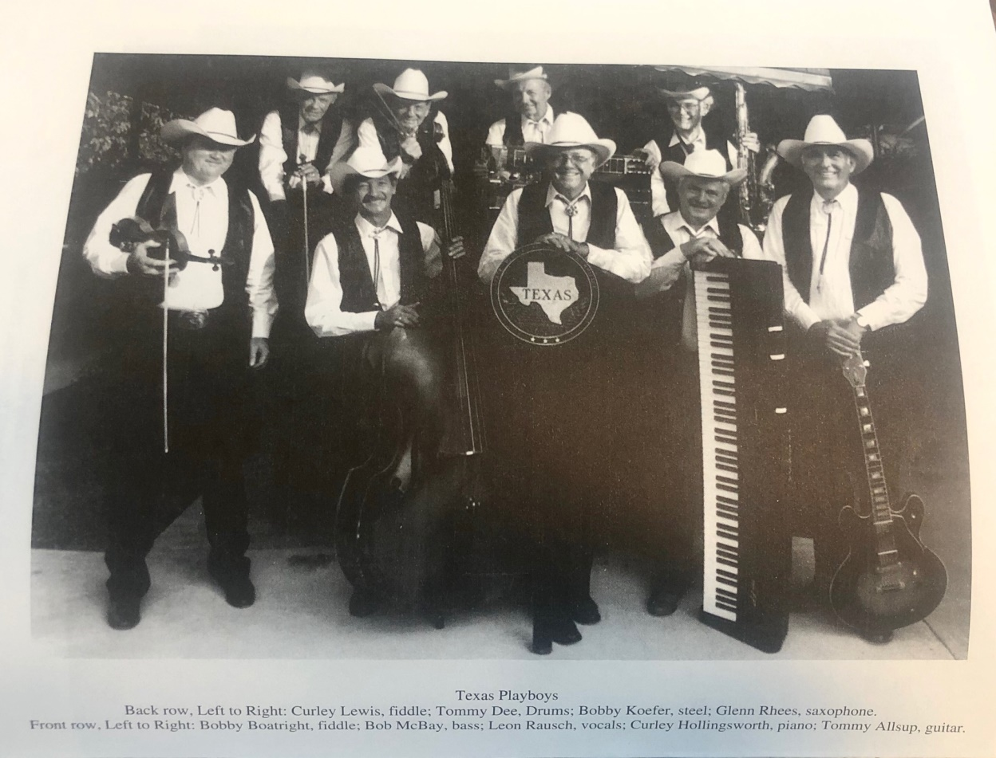
Leon Rausch
The Texas Playboys under the direction of Leon Rausch and Tommy Allsup

Slide 27
Leon Rausch

Slide 28
Leon Rausch

Slide 29
Leon Rausch

Slide 30
Tommy Allsup

Slide 31
Tommy Allsup
Born Thomas Douglas Allsup on November 24, 1931 in Owasso, OK
Known for touring with Buddy Holly 1958-9
“The Coin Toss”
Accomplished producer/session musician
Willie Nelson, Roy Orbison, Charlie Rich, Asleep At The Wheel, and countless others

Slide 32
Tommy Allsup
1970’s -
Move to Fort Worth; opened Tommy’s Head’s Up Saloon
Produced two albums for AATW
Produced “For The Last Time” (Bob Wills)
Directed The Texas Playboys with Leon Rausch after Bob’s death

Slide 33
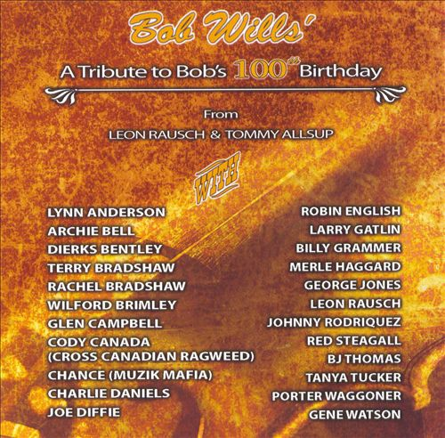
Tommy Allsup
Common Ground Records in Azle, TX
Produced “A Tribute to Bob’s 100th Birthday” 2005

Slide 34
Bob Boatright

Slide 35
Bob Boatright
Born September 30, 1939 in Denison, TX
(d. December 28, 2008)
Began playing fiddle at age ten
An academic!
Majored in math and physics at Midwestern State University in Wichita Falls
Taught at Cameron University in Lawton, OK, later at Weatherford Junior College
Started a family in the 60’s; played fiddle around Fort Worth dance halls

Slide 36
Bob Boatright
Hired to play in The Original Texas Playboys band with Leon Rausch, Tommy Allsup, and others
Played with Rausch for 35 years
Contributions and legacy -
Excellent ear and beautiful fiddle harmonies
Recorded multiple albums reviving old folk melodies and Western Swing
Mentoring youth musicians
He was a PRANKSTER…! ☺

Slide 37
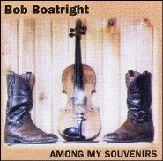
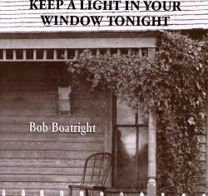
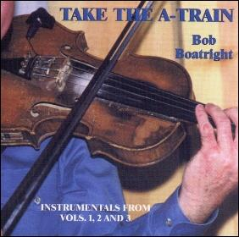
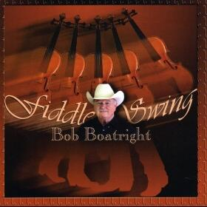
Bob Boatright Discography

Slide 38
Tommy “Wolf” Morrell

Slide 39
Tommy “Wolf” Morrell
Born October 31, 1938 in Little Elm, TX
Does this date sound familiar?
War of the Worlds Radio Broadcast on Oct 30, 1938
Ongoing joke that Wolf was an alien sent to us…
Played and recorded since the 1950’s with:
The Original Texas Playboys
Ray Price
Willie Nelson
Ernest Tubb
Tex Williams
Glen Campbell
Roy Lee Brown and The Musical Brownies
Asleep At The Wheel
And many others…..

Slide 40
Tommy “Wolf” Morrell
Recorded “How The West Was Swung” series with his band, The Timewarp Tophands
Fifteen volumes!
Joined The Texas Panthers with Leon Rausch, Leon Chambers, Tommy Dee, Bobby Boatright
Inducted into the Texas Steel Guitar Hall of Fame in 1988
Most of what I know about Tommy is an oral history and from our friendship…
Story time!
Died January 29, 2007 in Little Elm

Slide 41
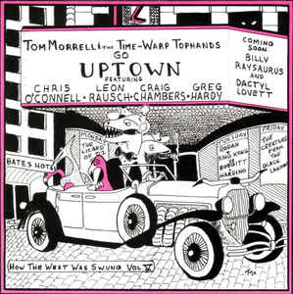
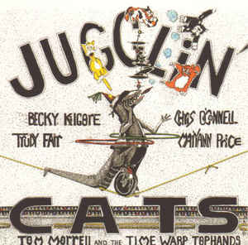
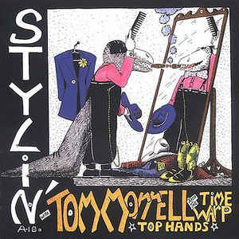
Select Tom Morrell Discography

